Slide 1

Power Supplies
- Linear and Switch Mode
Jamie Hall WB4YDL

Slide 2
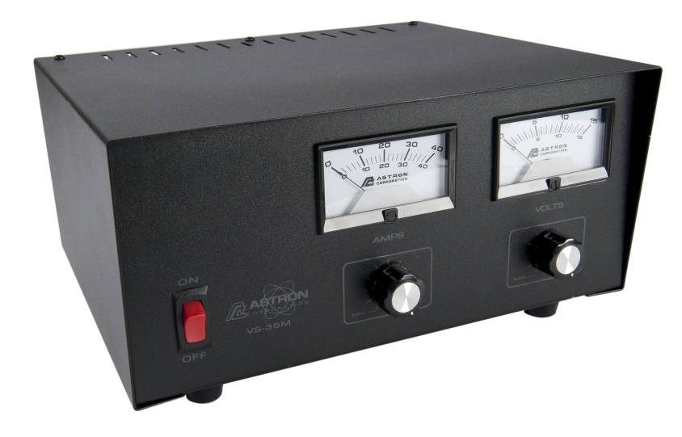
Linear Power Supply
Pros
Proven technology
Audibly quiet – generally no fans
No RF noise

Slide 3
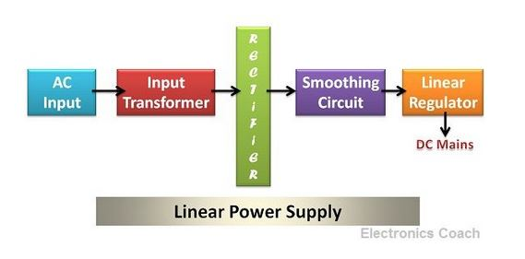
Linear Power Supply
Cons
Heavy & large
More expensive
Low efficiency

Slide 4
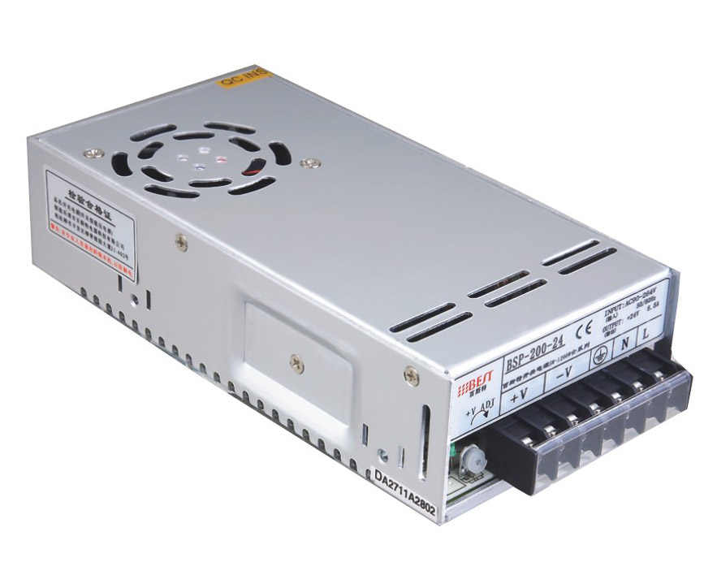
Switch Mode Power Supply
Pros
Light weight & small form factor
Less expensive
Highly efficient

Slide 5
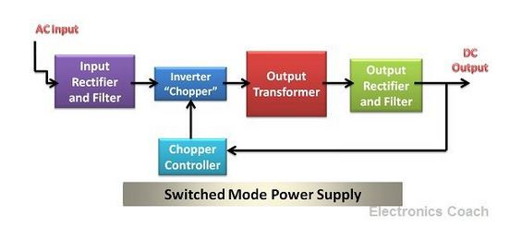
Switch Mode Power Supply
Cons
Fans are generally on and noisy
Possible RF noise
Complex circuitry

Slide 6
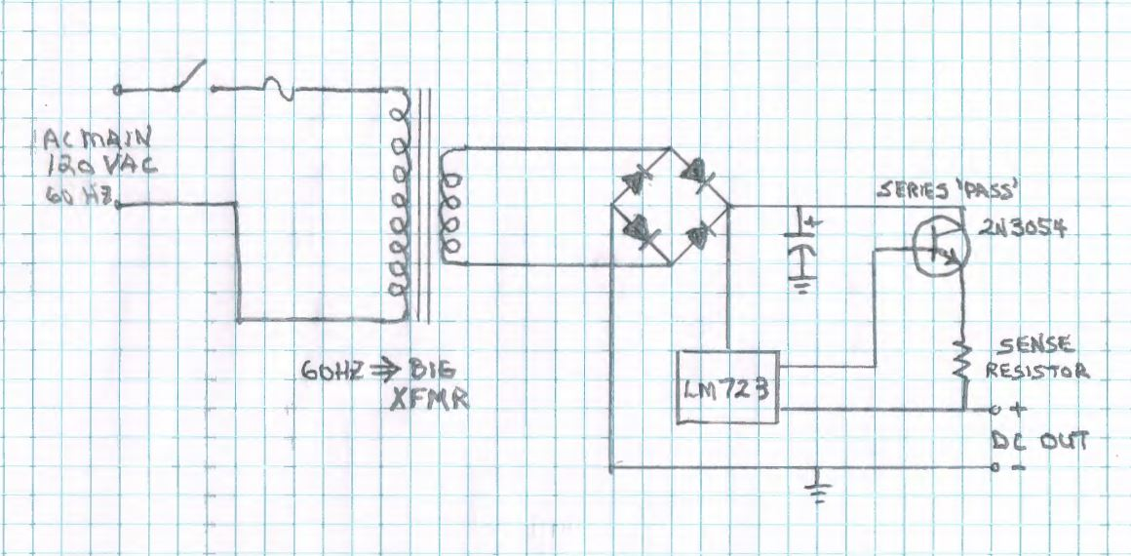
Linear Power Supply Schematic

Slide 7
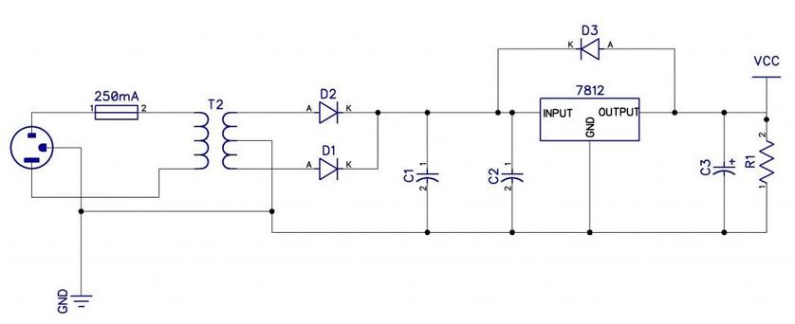
Small Fixed Output Linear PS

Slide 8
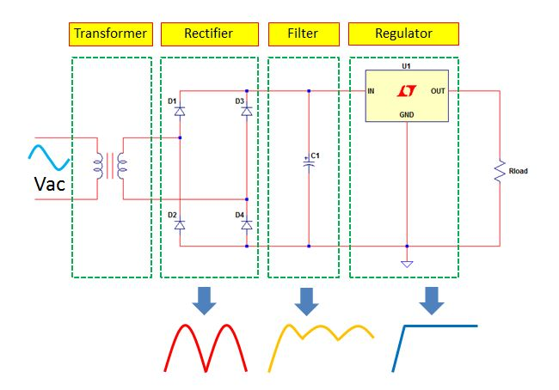
Linear PS Block Diagram

Slide 9
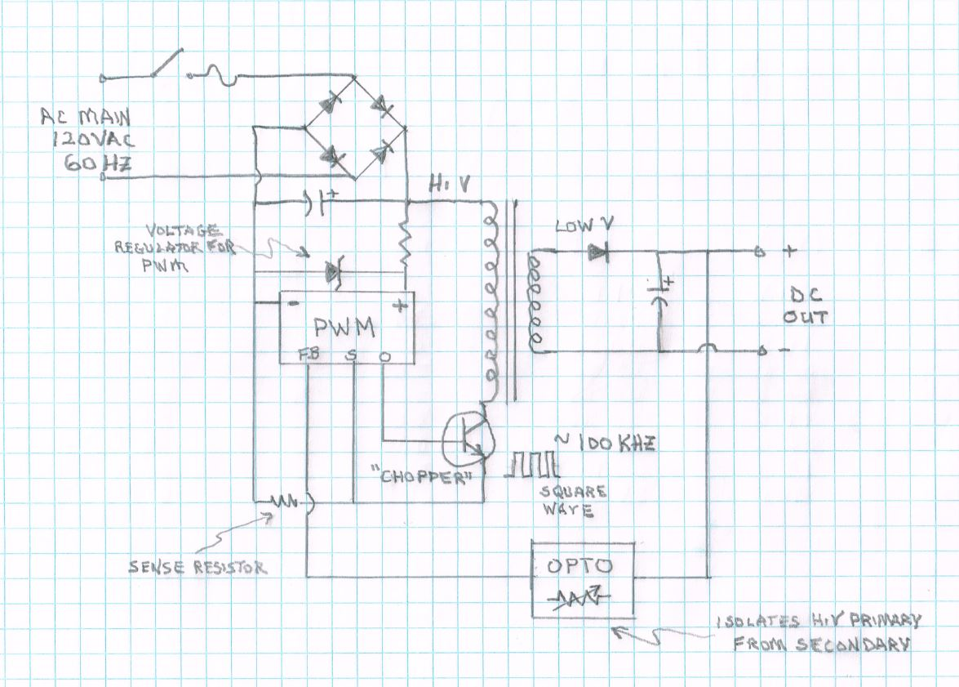
SMPS Schematic

Slide 10
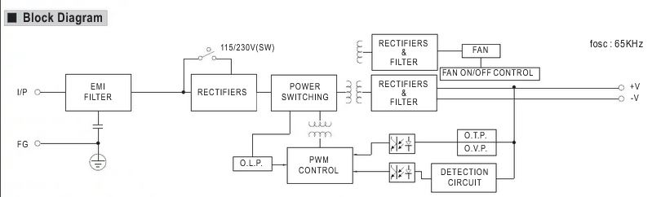
Meanwell SMPS Block Diagram

Slide 11
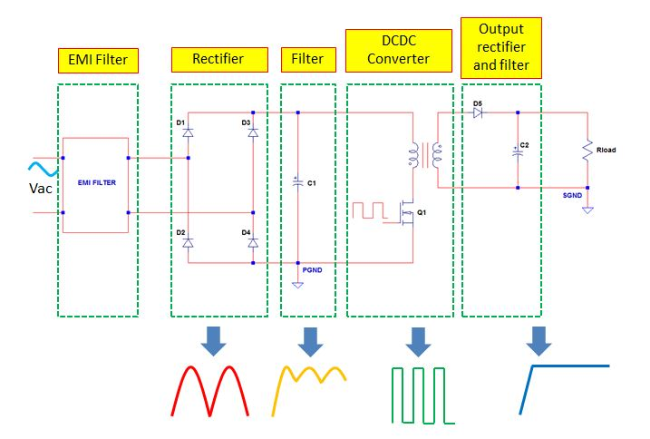
SMPS Block Diagram
Notes:
It’s the job of the receiver to select one signal, amplify it, and present that ONE signal to the detector (demodulator). Therefore, the receiver must suppress all other signals that come out of the antenna.

Slide 12
Decisions on Choosing a Power Supply
Determine radio amperage requirements
Determine desired power connectors
Consider the meters

Slide 13
Advice from WB4YDL
Linear PS’s are best choice for home station
Portable operations that don’t involve a battery choose switch mode PS

